Slide 1
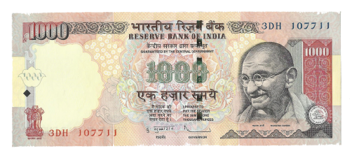
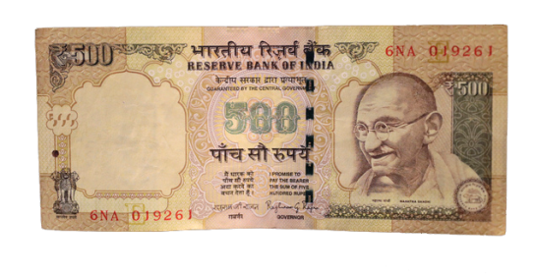
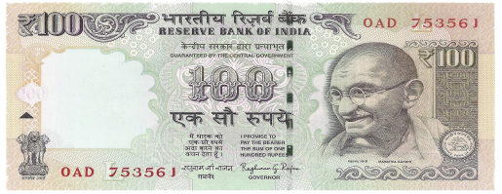
Black Money
Group Members :-
Aryan Gupta
Dushyant Sharma
Ashutosh Pareek
Rishabh Swami

Slide 2
What is 'Black money' and it's sources?
Black money can be earned through legal and illegal means and so it is the money earned but not shown in the accounts, simply for the purpose of tax evasion.
Initiation of black money can be very easy and we all may have contributed in it without even knowing ! Like:-You go to a local convenience store to buy something and do not ask for receipt. That purchase may not be recorded in the accounts of that store, he does not pay sales tax on it and the money you have paid him essentially becomes black money.

Slide 3
Problems caused by Black Money!
Terrorism(weapon trading) is one of the major problem in India and it is fueled by black money.
Economical growth is heavily disturbed by black money.
Future of India is being destroyed because of it. If we do not pay taxes properly to the government then how can we expect government to provide us with all our basic services.

Slide 4
Black Money On Global level !
If we discuss black money on a global level, India is on a whole another level in comparison with other countries.
Top 5 countries generating ‘Black Money’ :-
India > Russia > U.K > Ukraine > China
Swiss bank revealed that if India combine all its money with black money then it will have more money than rest of the world.
Even the 2nd Country Russia has 4 times lesser amount of black money in comparison with India.

Slide 5
Major reasons that led to Black Money
Faulty taxation:- There are many defects in tax structure like for some tax rate is very high and for some tax rules are very easy to bend in their favour or benefit.
Government lacks in monitoring who is properly giving taxes and who is not.
Lack of awareness among common people is also one of the reasons for the generation of black money. As people themselves help in promoting black money unconsciously.
For e.g; A property dealer sells a land for 1000rs , he has to pay some part of the sale to the government as tax for every piece of land. So he asks the buyer to pay 500rs(black money) in cash and rest of 600rs(white money) in cheque. Now he have to pay tax on 600rs only.

Slide 6
Measures to be taken against Black Money
The tax department should become more flexible and regulated as per to monitor the tax system.
On the other hand government also is trying their best to make black money disappear once and for all. Like:- The act of Demonetisation.
We still need more of these to completely stop the usage of black money. We ourselves should become responsible enough to remove black money from its root.

Slide 7
Conclusion !
The usage of black money is an illegal practice, but somehow we all are encouraging it in various known or unknown ways.
The usage of black money must be stopped as it is destroying our country’s future. Black money has created a black hole in Indian economy and day by day our future is being sucked in that hole.
Black money and Corruption are two sides of the same coin. It is a national threat and we all should become responsible and aware enough to fight it otherwise we all are doomed.

